Slide 1
Multi Biometric System
Ravitha N

Slide 2
Introduction
Use of Information from multiple biometric sources.
Unimodal vs multimodal
  Reduce Capture Noise
  Universality
  Resistant against impersonation attacks

Slide 3
Different Principles of Biometrics
Multi Algorithmic
  Use of different recognition algorithms
  Increase in processing cost
Multi Sensor systems
  Same biometric acquired through different sensors
  Capture highest level of detail
  Use of both resistive and capacitive fingerprint readers
Multi Instance systems
  Capture multiple instances of same modality
  Ex: Capturing both left and right iris

Slide 4
Contd..
Multi Sample
  Several captures of the biometric data
  Increase robustness to noise
Multimodal systems
  Use information from several biometric modalities
  Face recognition combined with speech recognition
Hybrid systems

Slide 5
Fusion
Retrieve information from subsystems
Combine them
Capture
Feature Extraction
Score
Decision (or) rank level
MB
Bytes
Byte
Bit

Slide 6
Capture Fusion
Multi sensor (or) Multi Sample systems
Create new data through image fusion (or) pixel fusion
In fingerprint recognition (single capture can provide only partial information)
Capture 1
Preprocessing
Fusion
Fused capture
Feature Extraction
Capture 2
Preprocessing

Slide 7
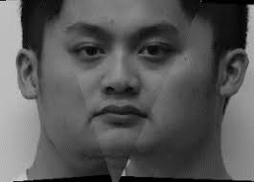
In fingerprint recognition , preprocessing could indicate possible deformation (or) alignment. (improved quality in capture)
Face recognition, panorama image from multiple viewpoints can be obtained. This method could be robust against pose variations

Slide 8
Feature Fusion
Multi sensor (or) Multi Sample systems
Multi Instance (or) Multi Modal systems
Obtain information that is robust w.r.t homogenous data (or) contain more information w.r.t heterogenous data.
Feature 1
Homogenization
Fusion
Fused Features
Matching
Feature 2
Homogenization

Slide 9
Feature Fusion
Data Type | Techniques
Homogenous | Attribute level fusion Weighted average (or) simple mean
Heterogenous | Concatenation Dimensionality reduction to retain more pertinent information

Slide 10
Score Fusion
Scores are produced after matching
Score fusion allows generation of new score from initial scores.
Score Transformation
Normalize and Combine
Normalization if distribution of scores from subsystems are different
Classifier
Find the function to separate classes in score space
Given set of scores corresponding to impostor and authentic user, it finds a function that can map score to the class label
Model Densities
Use probability membership to classify users
Model the distribution using mixture of Gaussian
A likelihood ratio is computed and then compared against the threshold

Slide 11
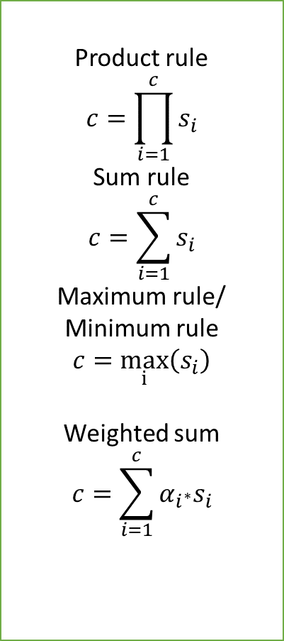
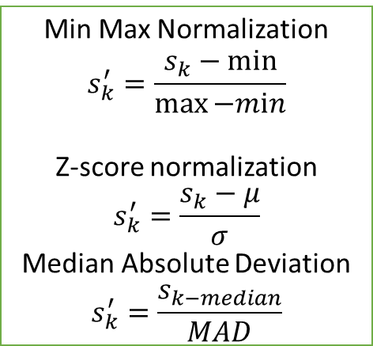
More prone to noise
Min Max Normalization
$$s_{k}^{′}=\frac{s_{k}−min}{\max{−mⅈn}}$$
Z-score normalization
$$s_{k}^{′}=\frac{s_{k}−μ}{σ}$$
Median Absolute Deviation
$$s_{k}^{′}=\frac{s_{k−median}}{MAD}$$
Product rule
$$c=\prod_{i=1}^{c}{s_{i}}$$
Sum rule
$$c=\sum_{i=1}^{c}{s_{i}}$$
Maximum rule/ Minimum rule
$c=\max_{ⅈ}\left(s_{i}\right)$
Weighted sum
$$c=\sum_{i=1}^{c}{α_{i^{∗}}s_{i}}$$
Less susceptible to noise
Score from subsystem 1
Normalization
Fusion
Final Score
Score from subsystem 2
Normalization

Slide 12
Rank / Decision level fusion
Combine the output of subsystems
Rank Fusion – Identification
Decision Fusion - Verification
User | Confidence score/Rank
A | 1
C | 2
B | 3
After Fusion
User | Confidence score/Rank
A | ?
C | ?
B | ?
User | Confidence score/Rank
C | 1
A | 2
B | 3

Slide 13

User | Confidence score/Rank
A | 1
C | 2
B | 3
Highest Rank Method
User | Confidence score/Rank
A | 1
C | 1
B | 3
User | Confidence score/Rank
C | 1
A | 2
B | 3
Logistic Regression
Borda Count
Weighted voting $w_{1}=0.8{ w}_{2}=0.2$
User | Confidence score/Rank
A | 3
C | 3
B | 6
User | Confidence score/Rank
A | 1.2
C | 1.8
B | 3

Slide 14
Decision subsystem
Accept / reject
Rules for combining decisions
  Logical and
    All subsystems should recognize user
    Less FAR high FRR
  Logical OR
    At least one of the subsystem should recognize user
    High FAR less FRR
  Majority Voting
    Half of the subsystems should recognize the user

